Slide 1
Whiskey In a Canteen Presents ‘Walrus’
Shrutheesh R Iyer
Abhilash R Namboodiri
Vijay Koundinya

Slide 2
Problem Statement - Movie dataset analysis
Develop a movie analyzer system that attempts to understand a movie and predict similar movies that is coupled with a recommendation system.

Slide 3
Tools and APIs Used
IBM Watson Natural Language Understanding Service - Analyze text to extract concepts, keywords, emotion using natural language understanding.
Google Pre-trained word2vec model – Find closeness between words to establish similarity between entities.
MediaWiki API – Extract contents from Wikipedia page to perform analysis
Kivy Cross Platform Application Development – Create desktop application.

Slide 4
Implemented Components
Select Movie
Movie Details
Emotion Analyzer.
Concept Analyzer.
Artist Analyzer.
Movie Character Similarities.
Emotion Analyzer
Concept Analyzer
Artist Analyzer
Recommended Movie
Movie Character Similarities

Slide 5
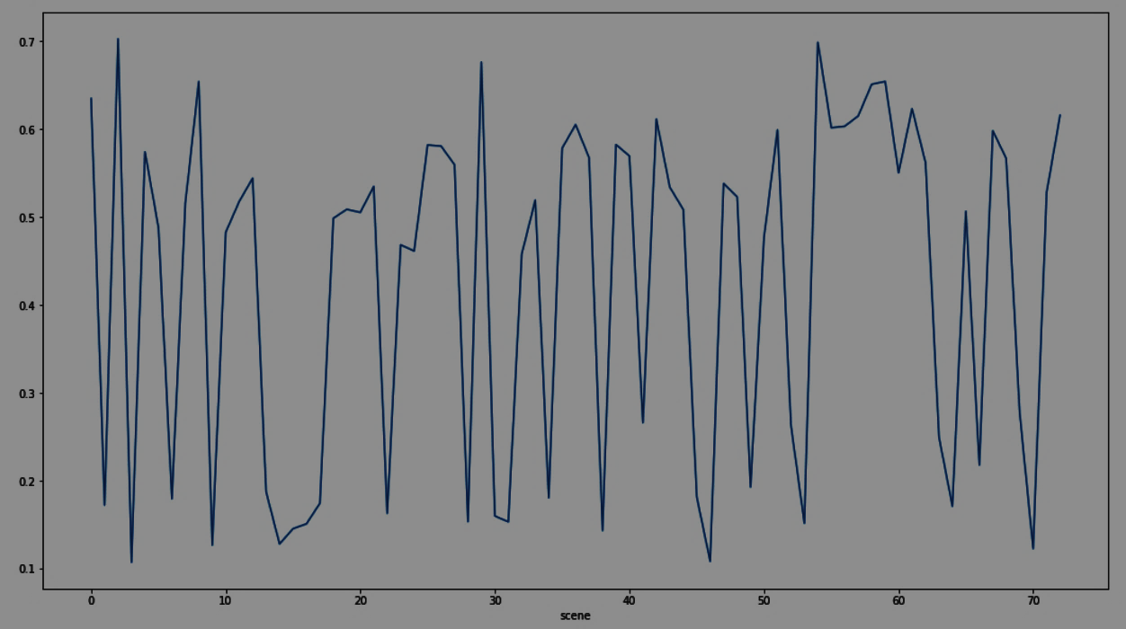
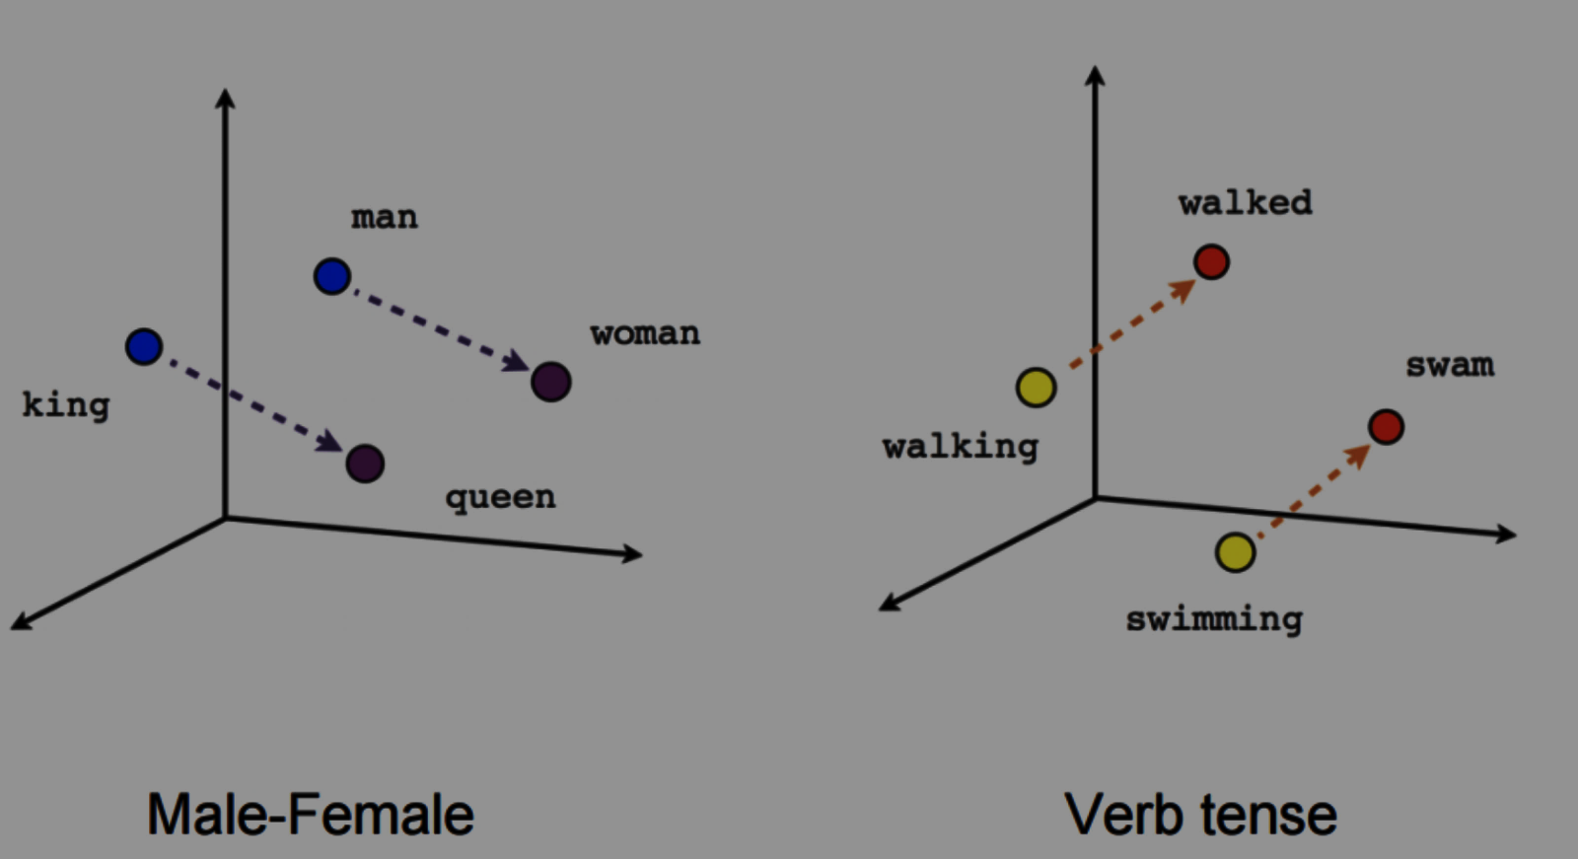
Functional Modules
Concept Analyzer
From the plot of each movie, the basic concepts are obtained using the IBM Watson NLU API Service. With the help of Google word2vec model, it finds other movies that have similar concepts and plots.
Emotion Analyzer
Using the Natural Language Understanding(NLU) API, analyzes the trend of 5 emotions across every scene of the movie, and finds other movies that have similar patterns of emotion changes.

Slide 6
Functional Modules
Artist Analyzer
Using the MediaWiki API provided by Wikipedia to access data, the primary artists of the movie, the actors and directors are taken and the module finds other movies that have the same artists who have worked in it. The artist analyzer gives a more recognizable touch to recommendation of movies(insert better)
Character Similarity
Once the movies are recommended, to provide a personal touch and how the movie may be similar to the original movie, the characters from the recommended movie are matched with characters of the previous movie based on similarity index, which is calculated using the word vector file provided in the dataset.

Slide 7
Role of Team Members
Shrutheesh Raman Iyer : Developed Concept Analyser.
Vijay Koundinya: Developed Wiki Api based Artist Analyser.
Abhilash R Namboodiri: Developed Emotion Analyser.

Slide 8

UI/UX Development
Alphabet Listview
Movies Listview
Movie Information
Movie Recommendations by each module
Kivy: Python based GUI Platform

Slide 9
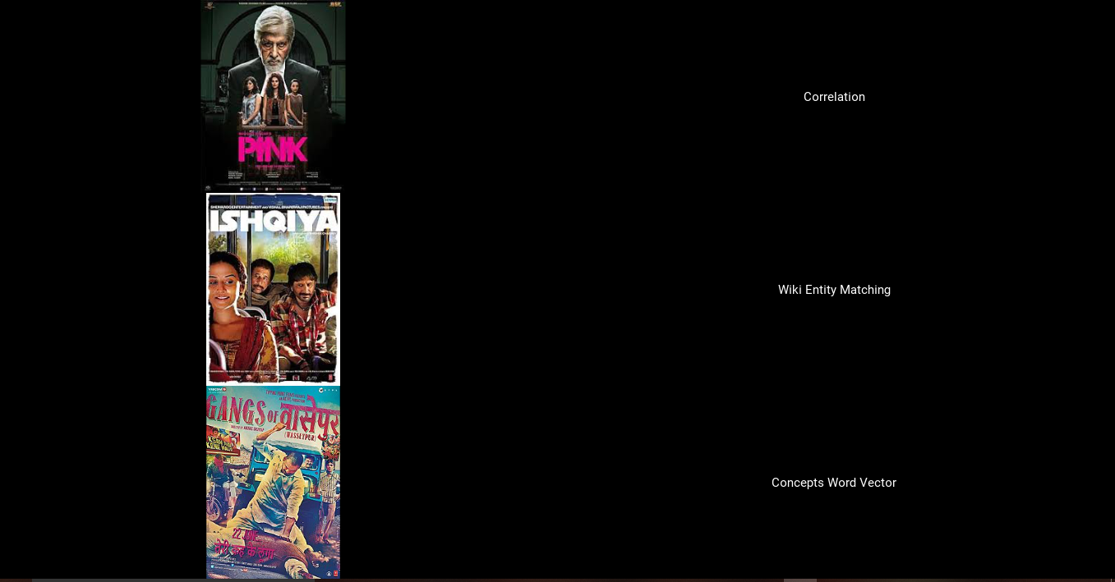
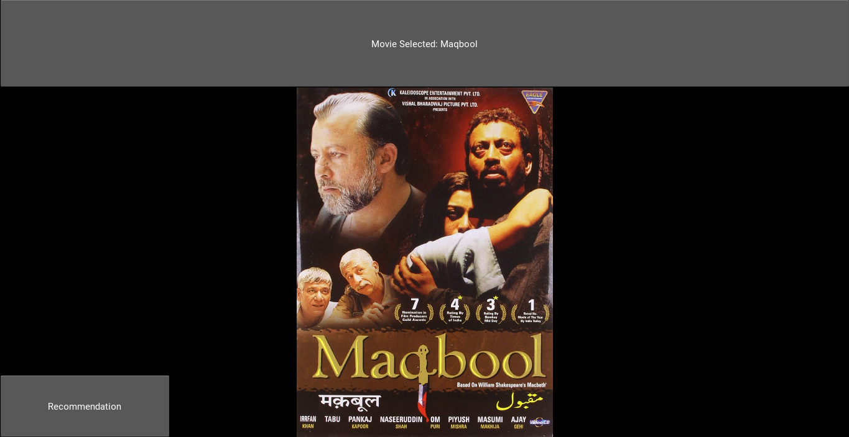
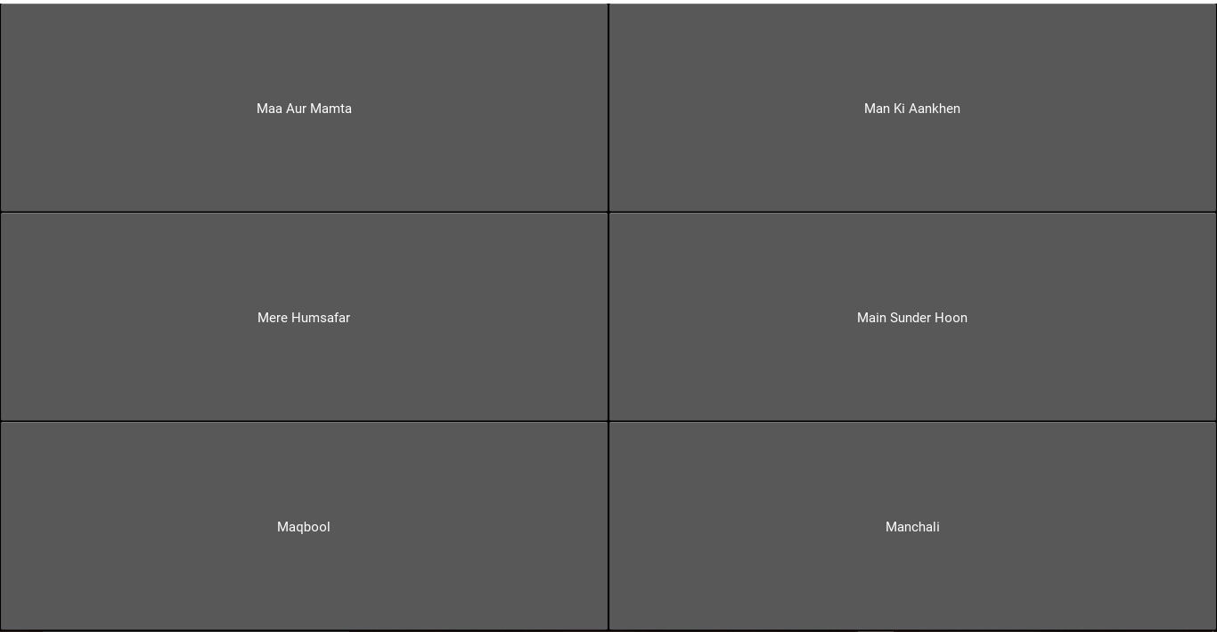
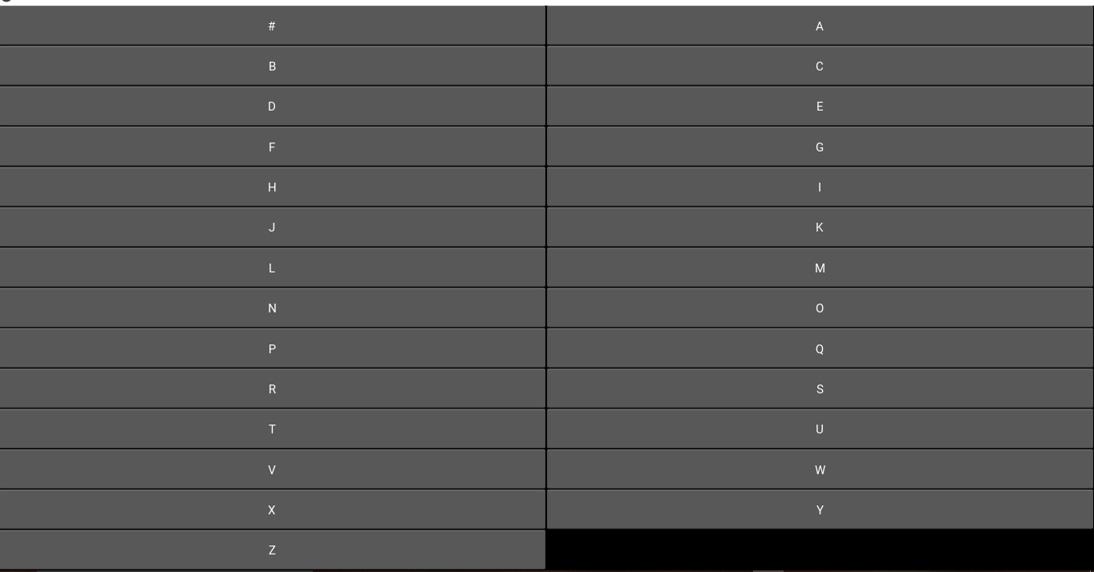
Screenshots of Working System

